Slide 1




Indicators of Heart Disease Dataset
Group 15:
Aneela Gannarapu
Shravan Naidu Gollu
Indu Narasingula
Manogna Chenuru
Mounika Kasragadda

Slide 2
PROJECT SCOPE
The BRFSS dataset from the CDC offers immense opportunities in the realms of public health and healthcare innovation. It encompasses extensive data on behavioral risk factors that contribute to heart disease, the leading cause of death worldwide. By employing advanced machine learning algorithms, we can predict and mitigate heart disease risks, paving the way for more effective prevention strategies. Additionally, our focus on sophisticated data visualization techniques ensures the complex information is transformed into clear, actionable insights. This not only aids healthcare professionals in making informed decisions but also enhances public awareness and understanding of heart disease risks. The project focuses on healthcare technology, promising significant advancements in heart disease prevention and management. It has the potential to significantly reduce healthcare costs and improve patient outcomes.
Notes:
The project focuses on data visualization and machine learning in the field of public health and healthcare. The machine learning component utilizes a dataset from the Behavioural Risk Factor Surveillance System (BRFSS) of the Centres for Disease Control and Prevention (CDC) to identify and avoid heart disease risk factors. This involves developing machine learning algorithms to forecast and control the risks of cardiac disease. Furthermore, the initiative broadens its focus to include data visualization methodologies, with the objective of furnishing clear and perceptive graphical depictions of the dataset. The combined scope provides a thorough method that improves comprehension and decision-making in the prevention of heart disease by leveraging both machine learning and visualization.

Slide 3
RESEARCH OBJECTIVES/KPIs
Accurate Identification of Risk Factors
Effective Preventive Action
Minimizing False Positives
Risk Factor Identification Rate
Overall Model Accuracy
Notes:
Accurate Identification of Risk Factors: To develop a model that accurately identifies key factors contributing to heart disease.
Effective Preventive Action: To ensure the model's recommendations lead to successful preventive actions or interventions.
Minimizing False Positives: To achieve high precision in identifying true heart disease risk cases while minimizing unnecessary interventions.
Risk Factor Identification Rate: Measures the accuracy in pinpointing contributing factors to heart disease.
Overall Model Accuracy: Gives an overall assessment of the model's performance in identifying and preventing heart disease risk factors.

Slide 4
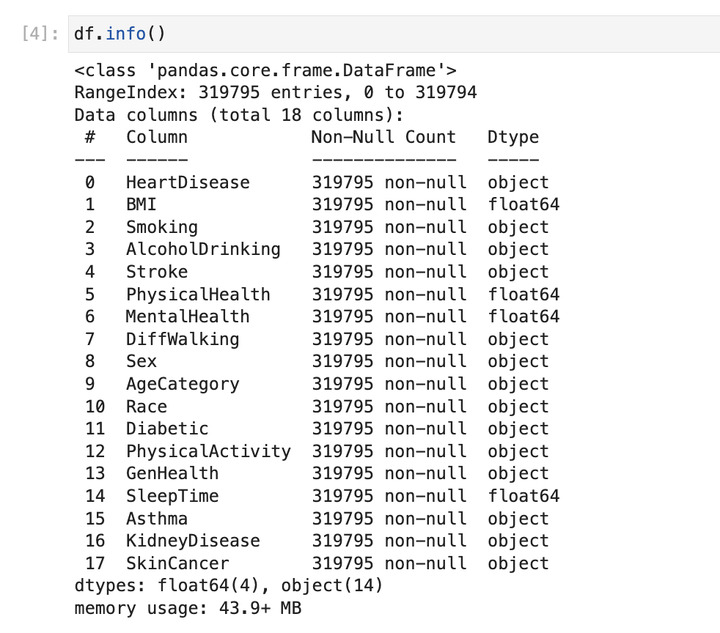
Data Source and Domain
We selected the data set from Kaggle active competitions officially maintained by Centers for Disease Control and Prevention. The domain of the project is Healthcare and Public Health.
Notes:
319795 records and 18columns:
Stakeholders in this domain include healthcare providers, researchers and individuals concerned with public health. The major attributes implemented to perform analysis within the dataset are detailed as below:

Slide 5
Git Repository Structure Overview
Repository divided into four branches
Main branch
Branch1: Deliverable 2
Branch2: Deliverable 3
Branch3: Deliverable 4
Documentation and File Upload:
Updated README file for each deliverable
Provides detailed information about branch contents and progress
Final Integration
Post-Deliverable 4: Merging Strategy
All branches to be merged after final grading of Deliverable 4

Slide 6
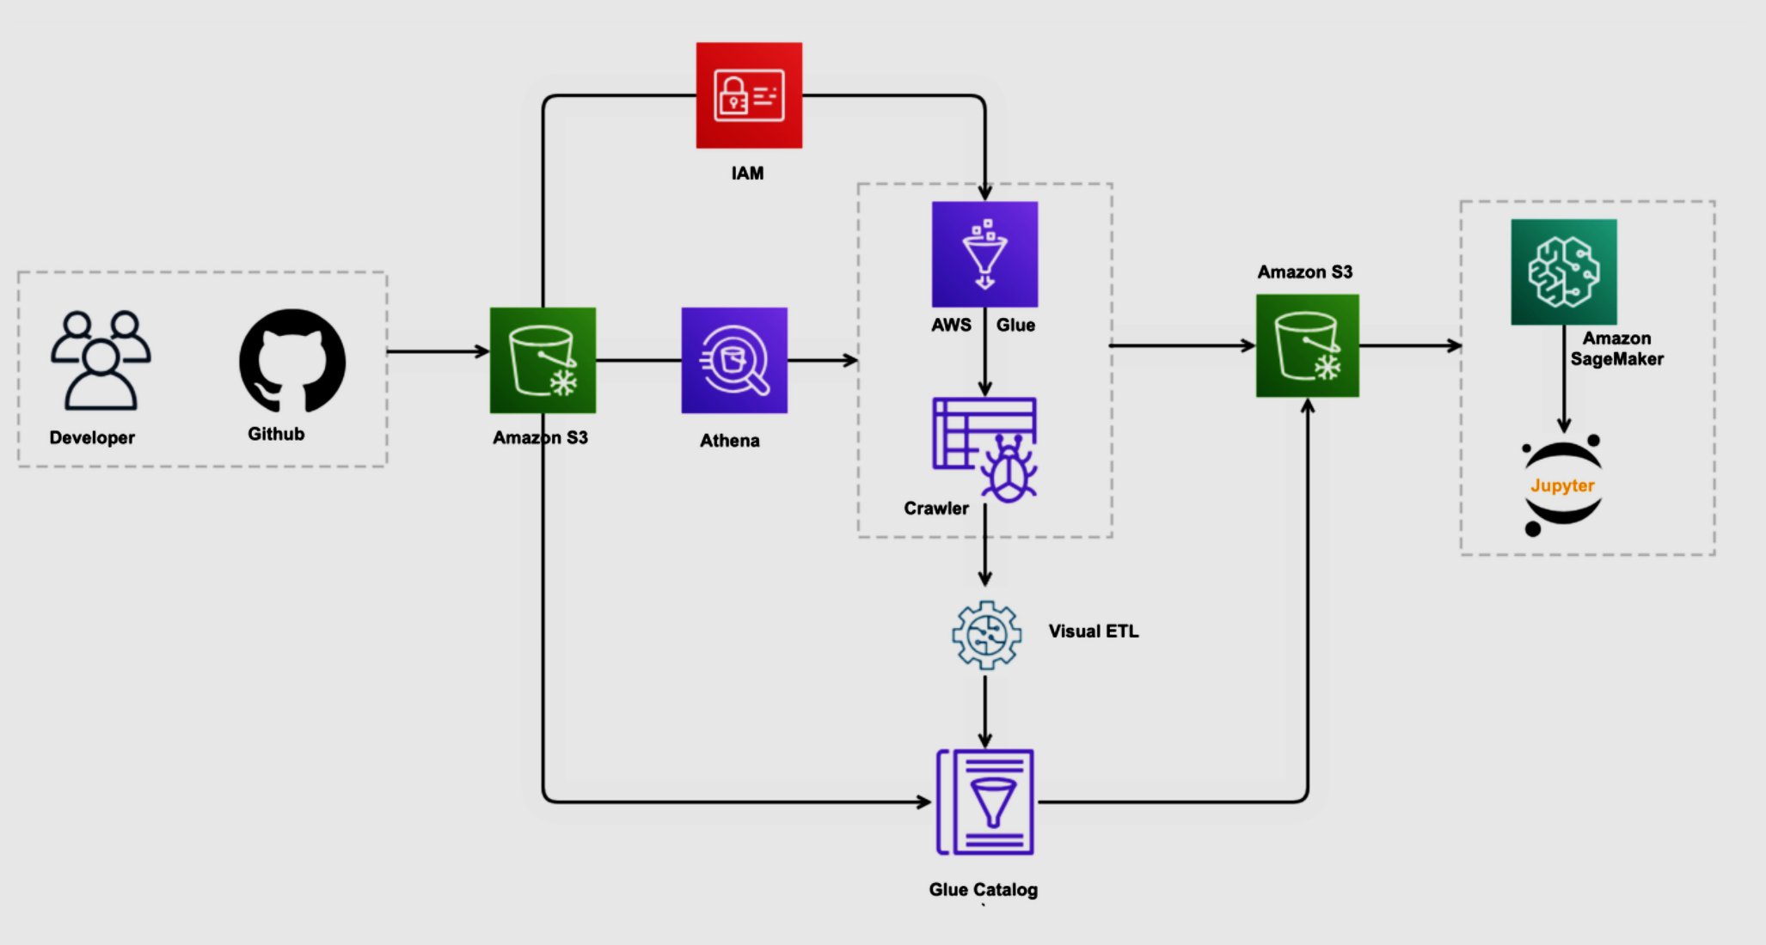
AWS Pipeline

Slide 7
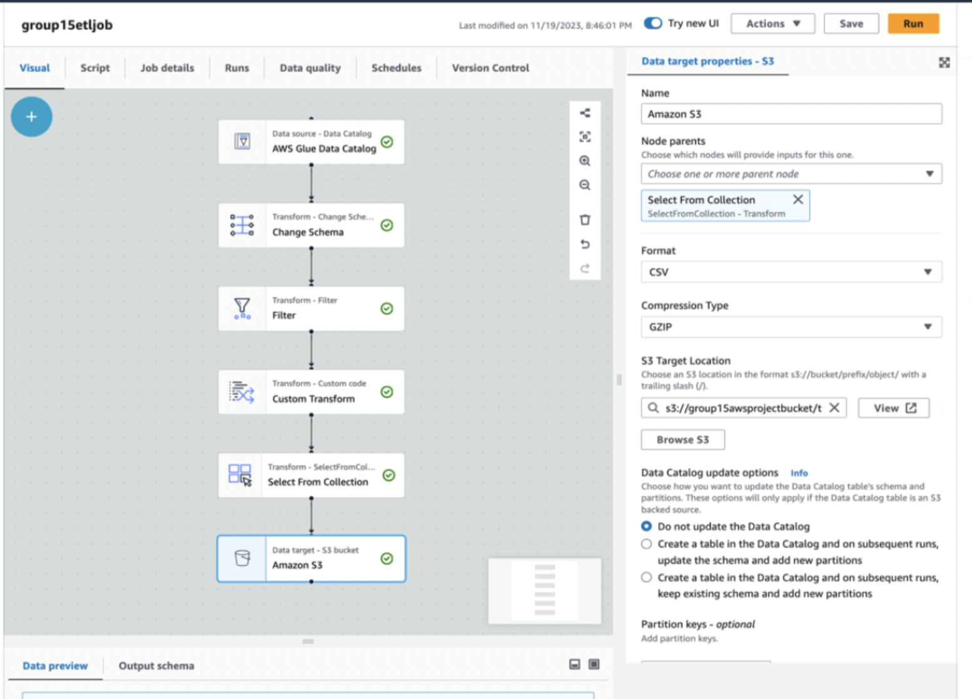
ETL Job

Slide 8
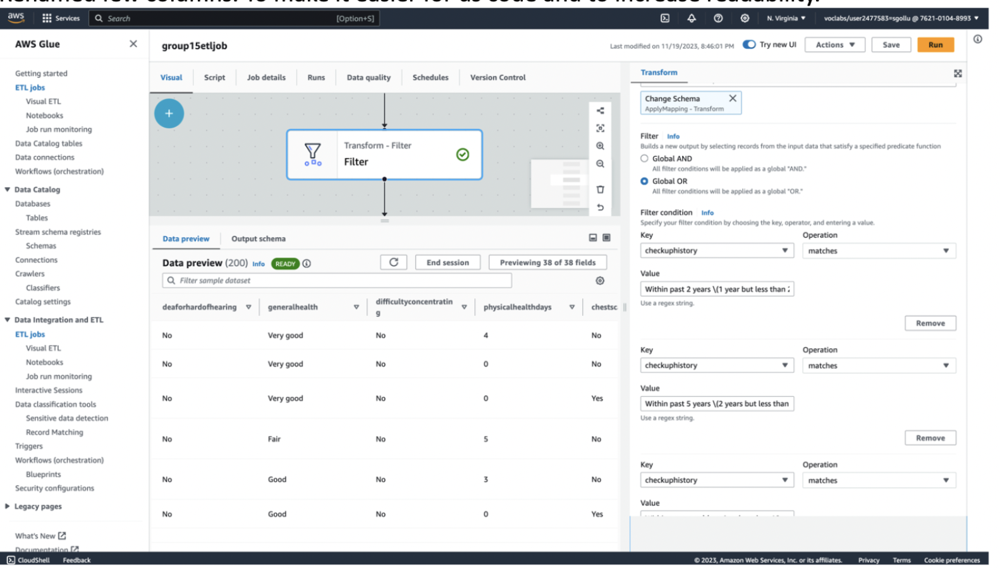
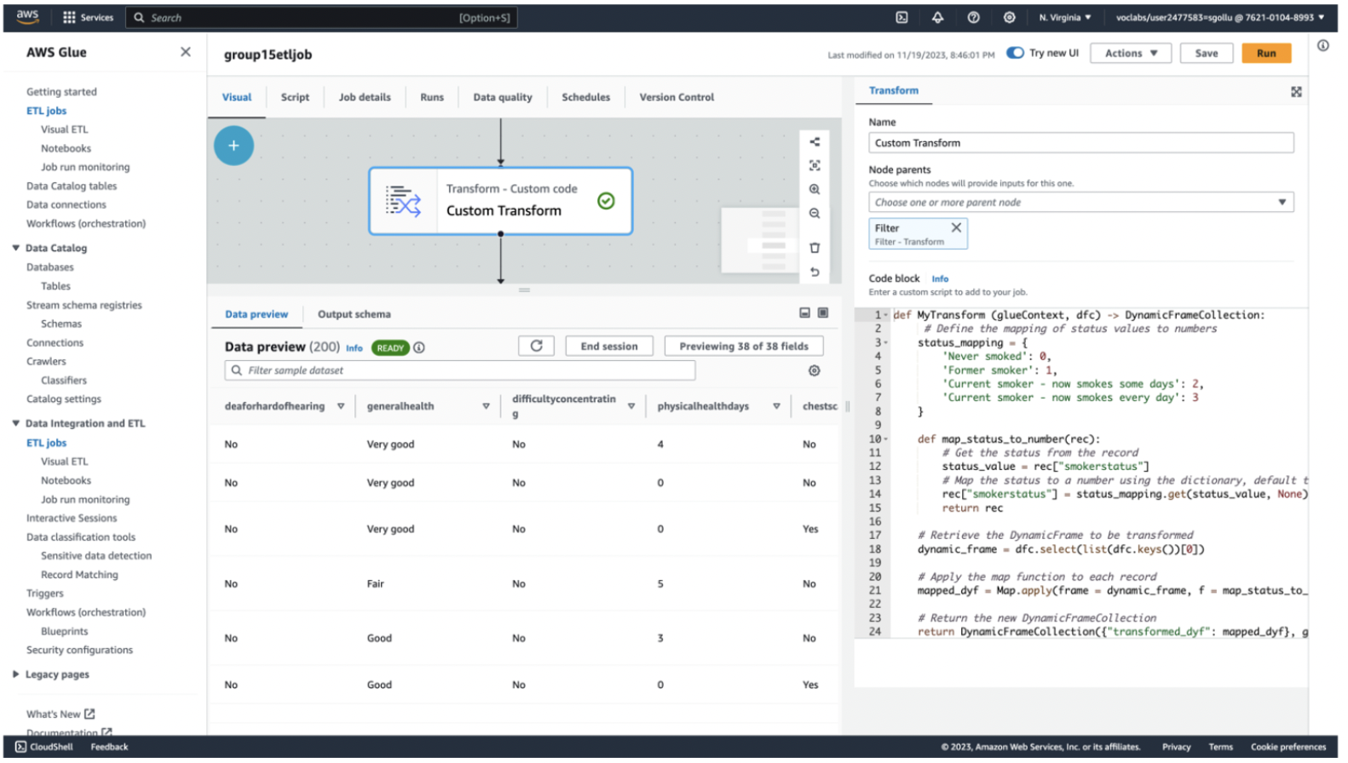
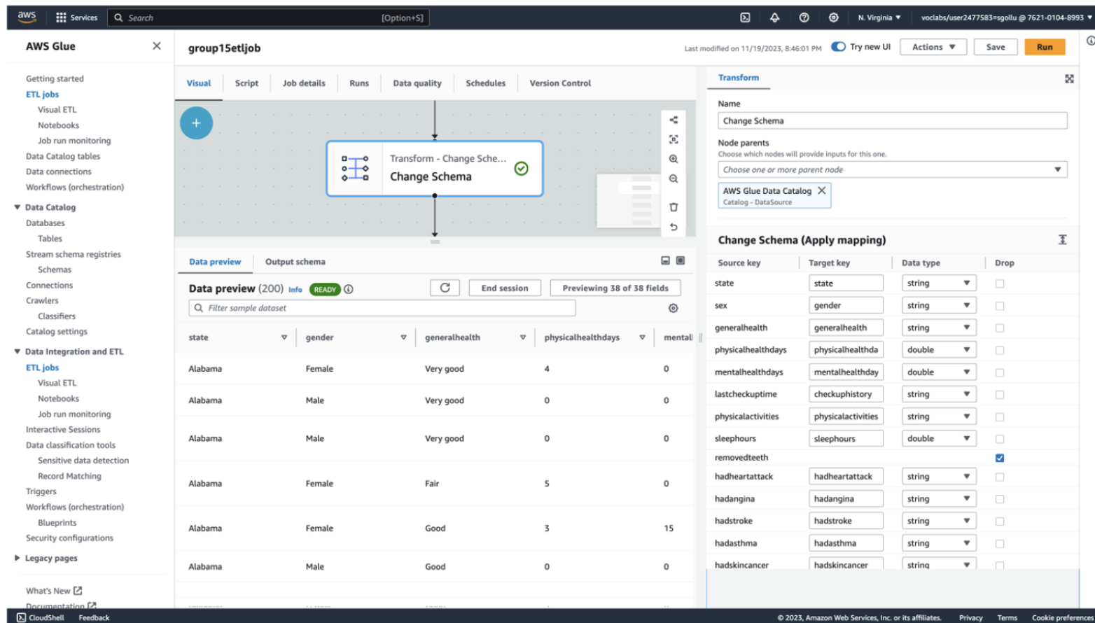
Transforms Incorporated

Slide 9

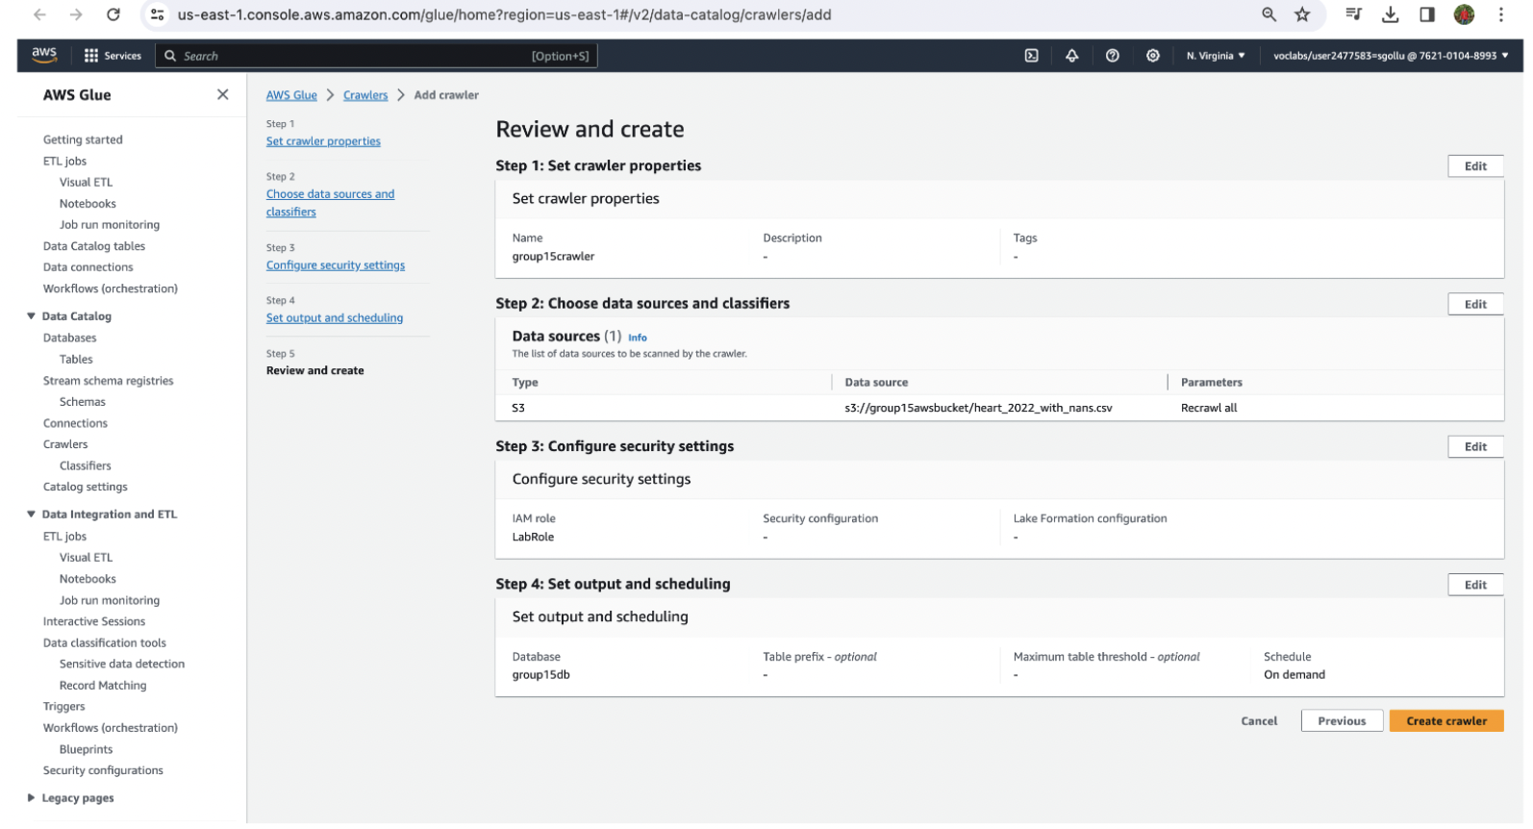
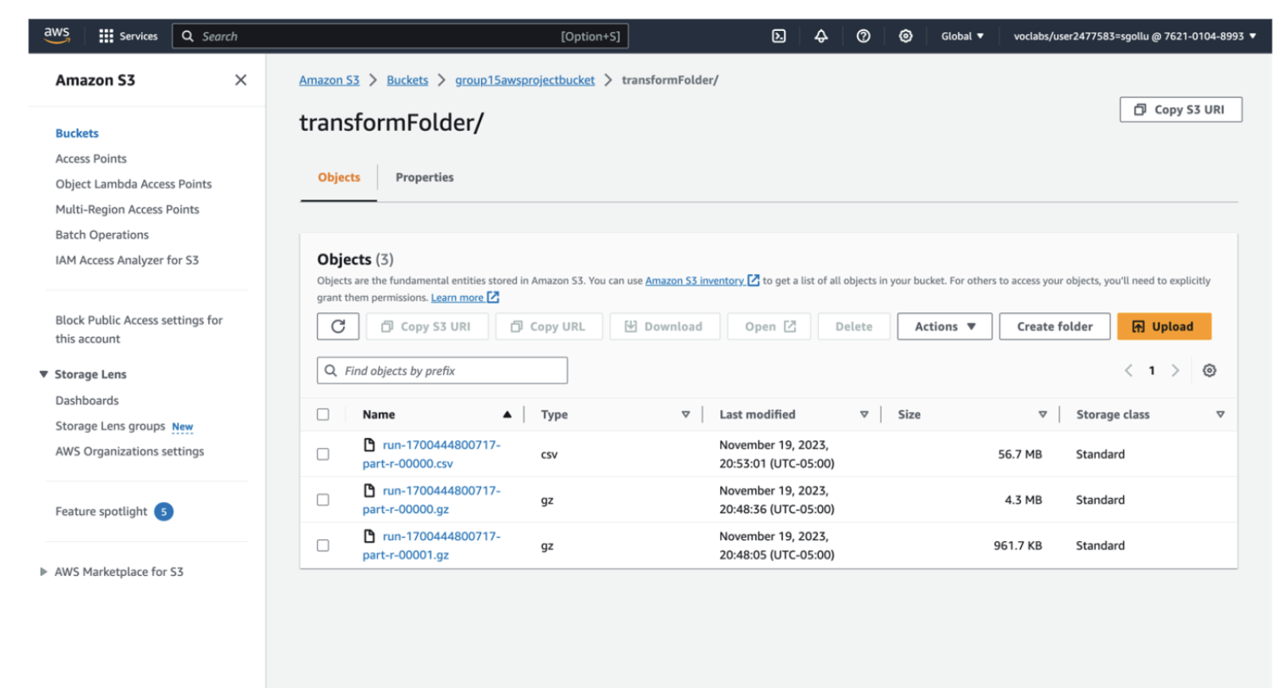
LOADING THE TRANSFORMED DATA

Slide 10
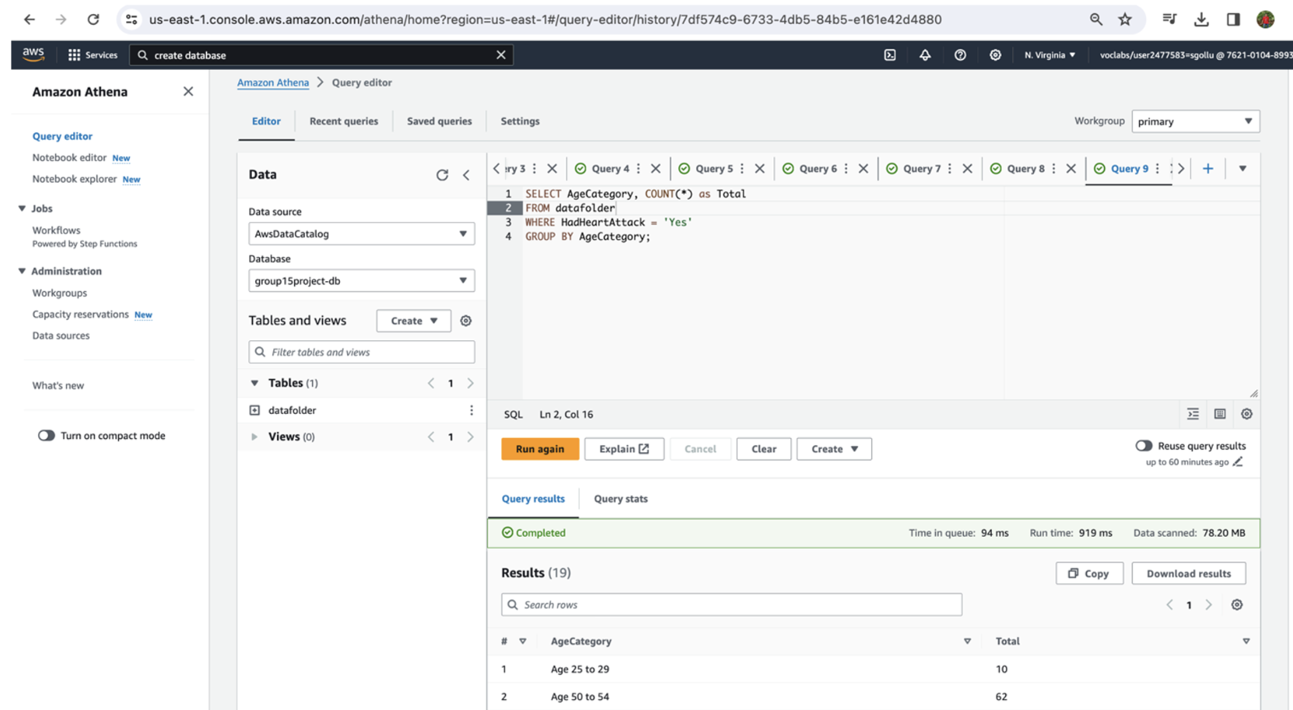
QUERYING THE DATA
AWS Athena is used
Multiple queries were performed to better understand the data
For Instance: Query to understand heart attack trends in different age groups

Slide 11
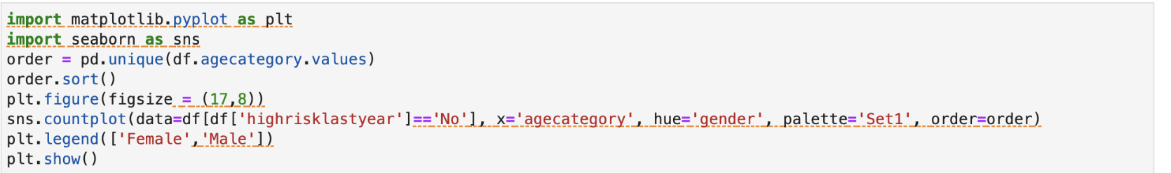
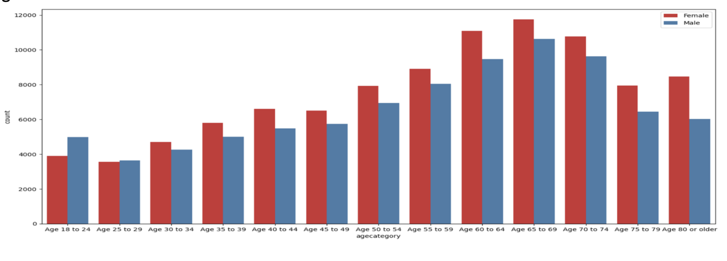
EXPLORATORY DATA ANALYSIS
Understanding the number of cases by segregating data with respect to age and gender

Slide 12
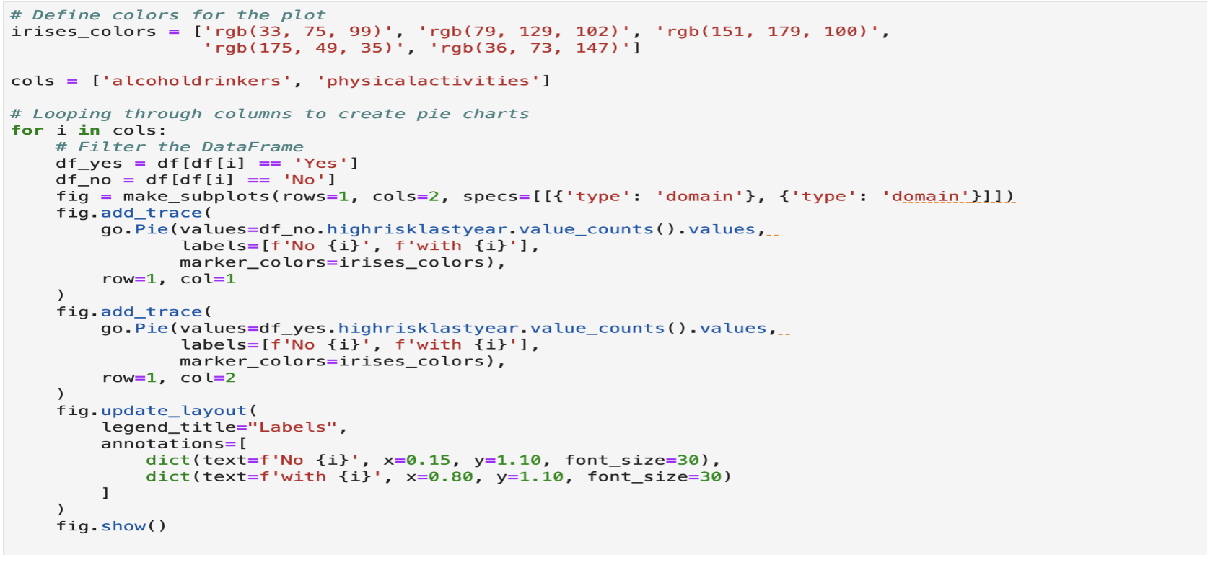
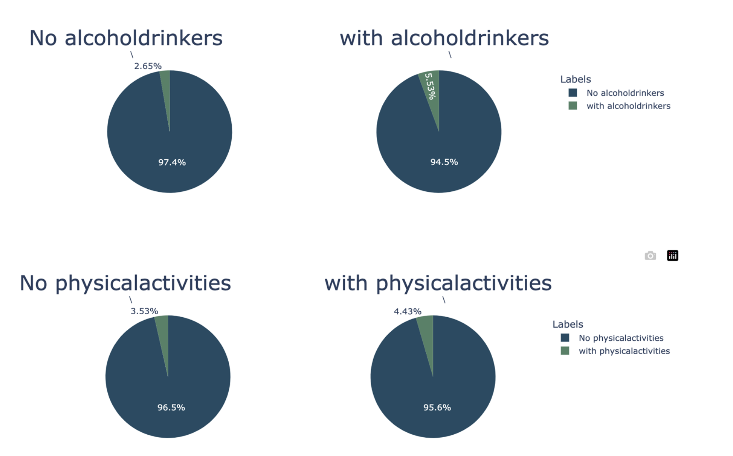
Contd..
Understanding the impact of alcohol and physical activity on heart disease

Slide 13
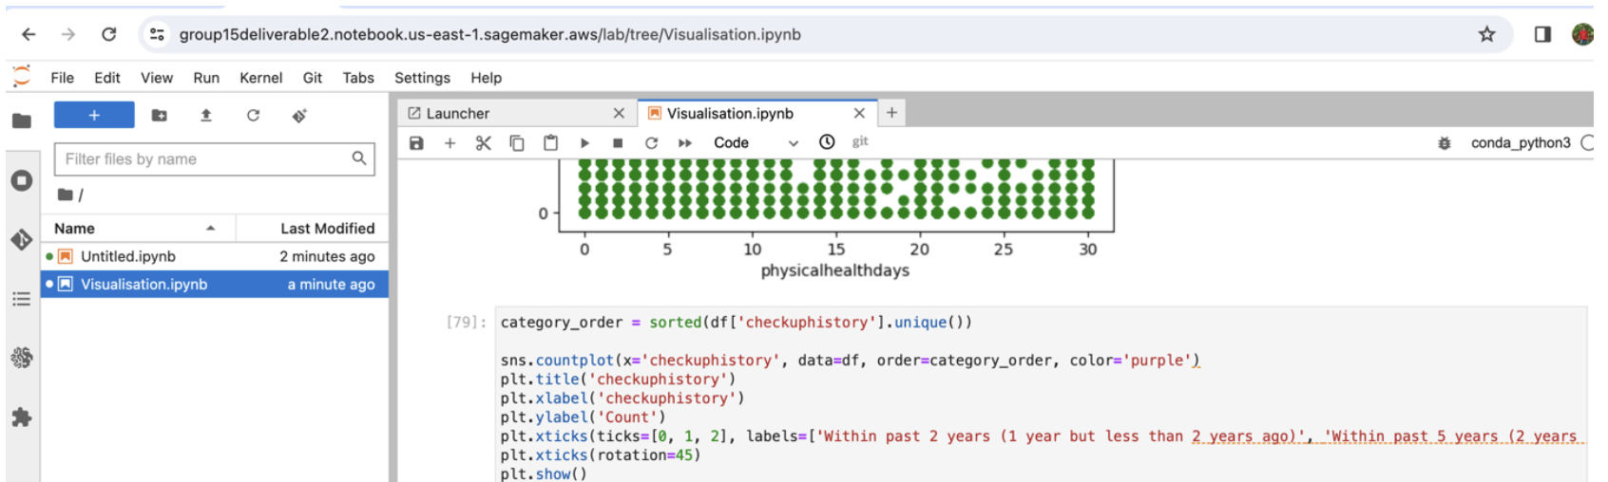
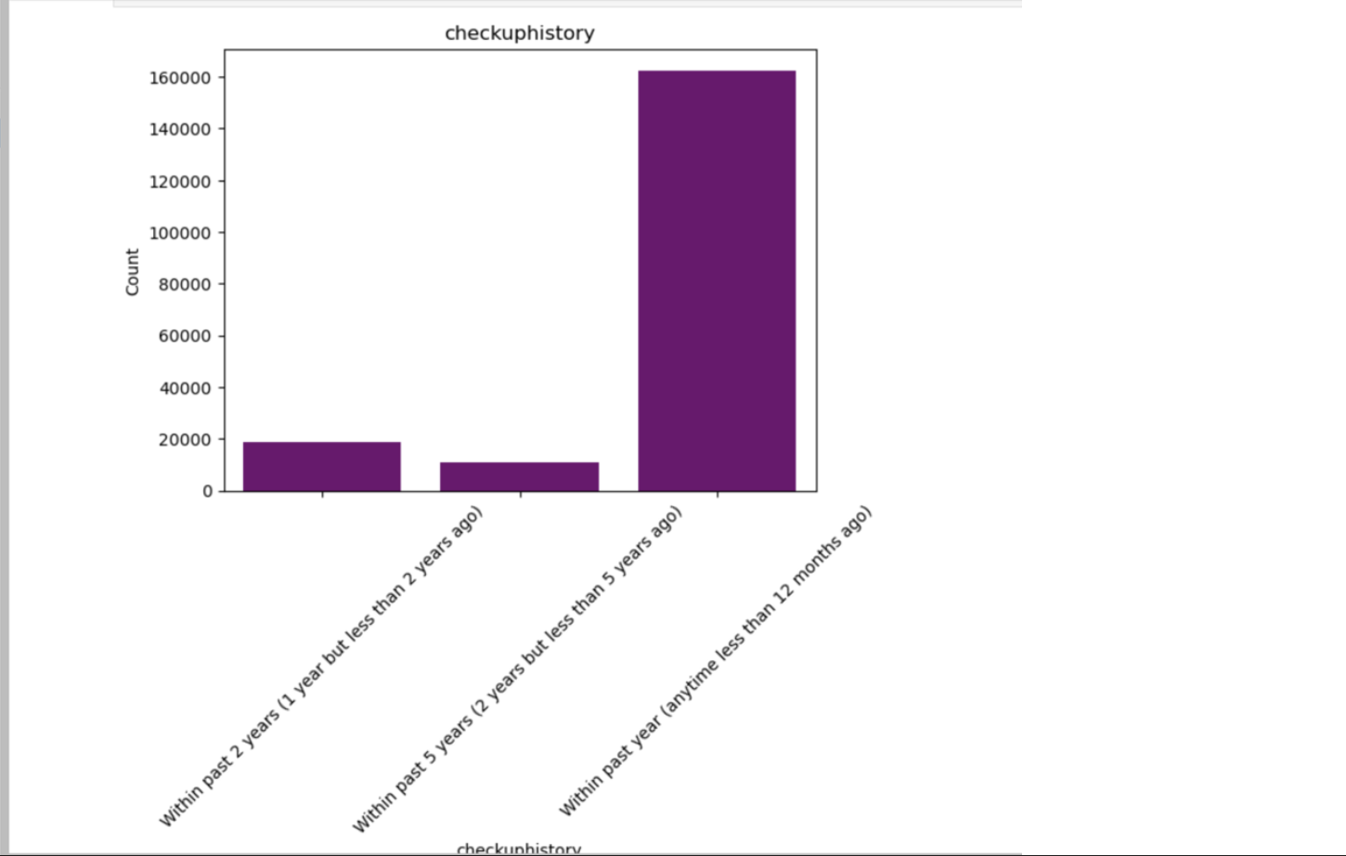
Contd..
Understanding the number of heart attacks and frequency of health check ups

Slide 14
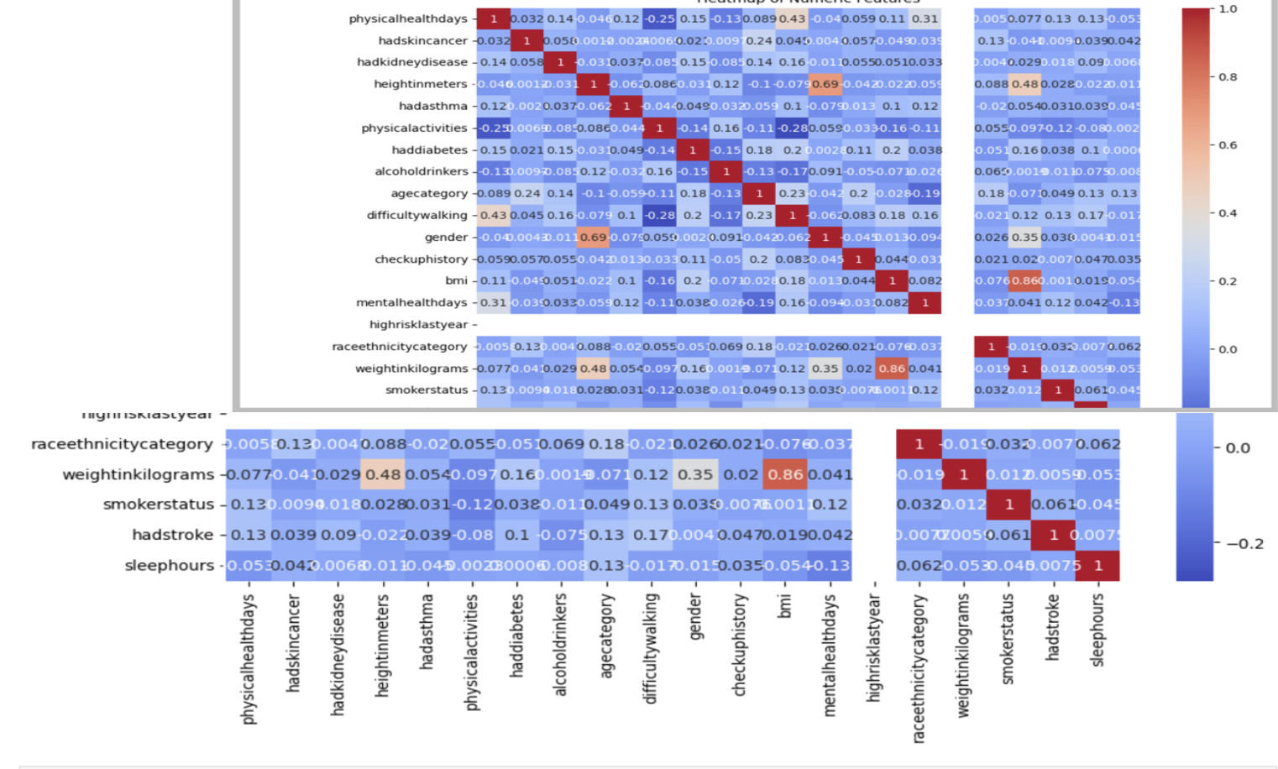
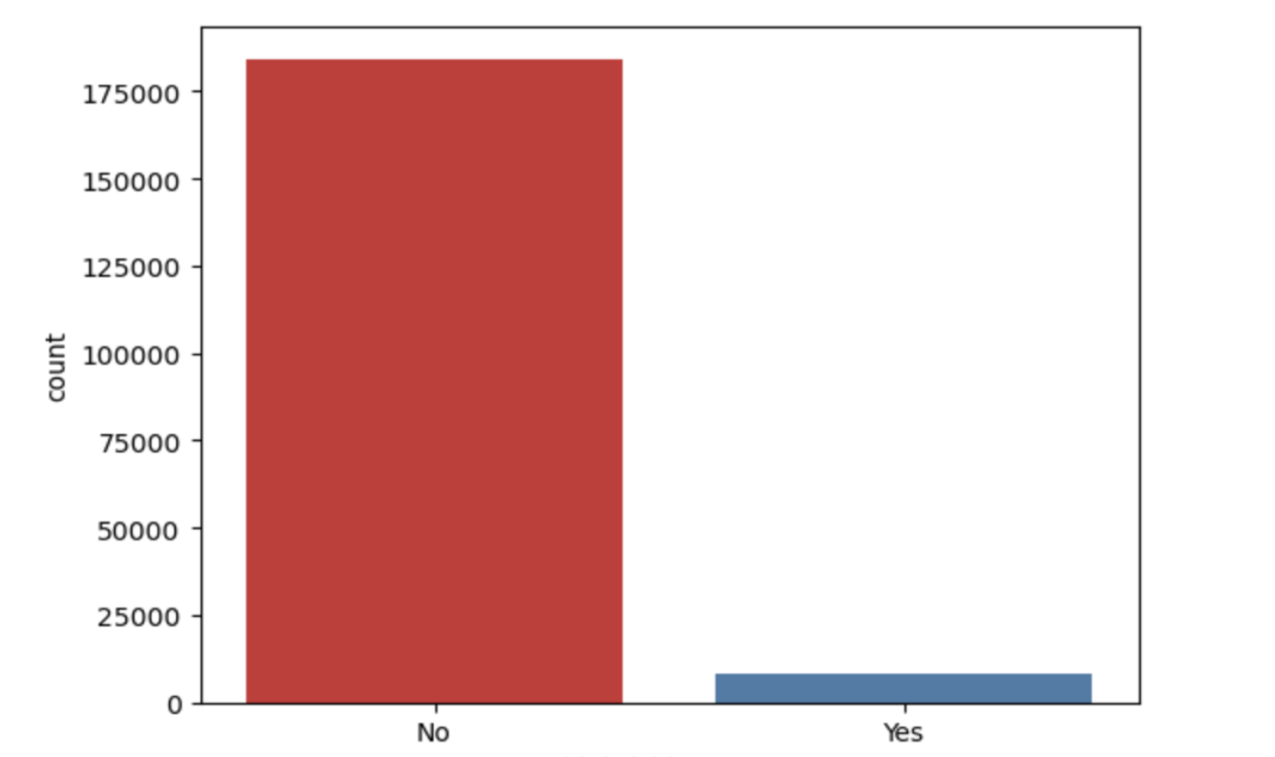
Correlation Matrix and Decision Attribute

Slide 15
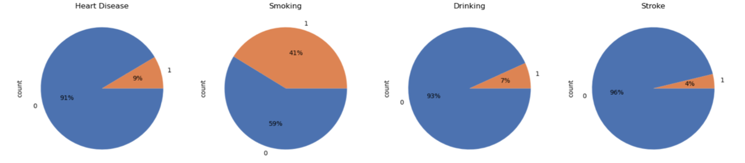
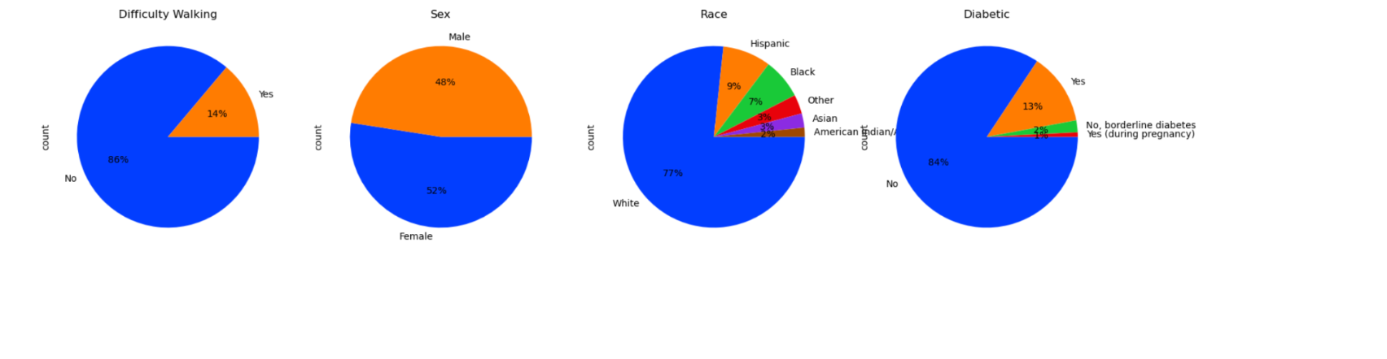
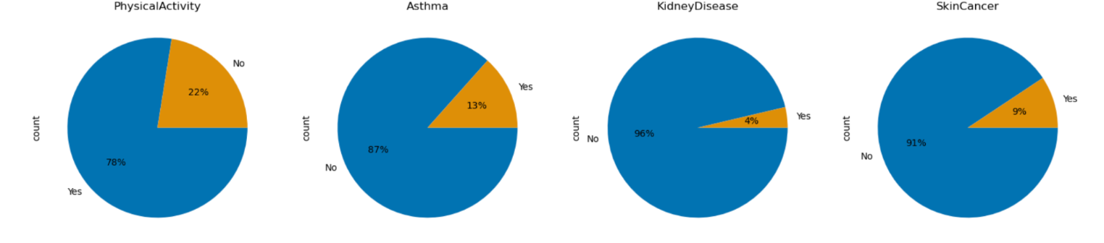
Understanding Data Distribution

Slide 16
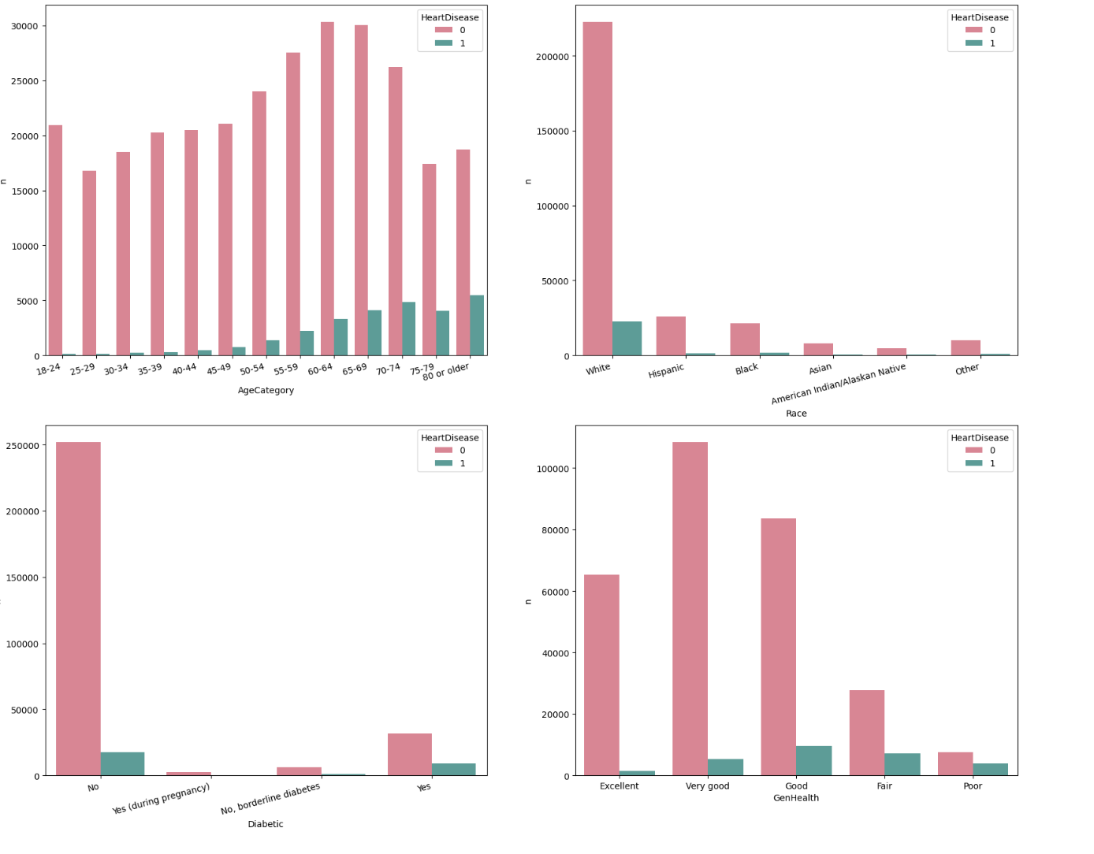
HEART DISEASE CLASSIFICATION FOR VARIOUS ATTRIBUTES

Slide 17
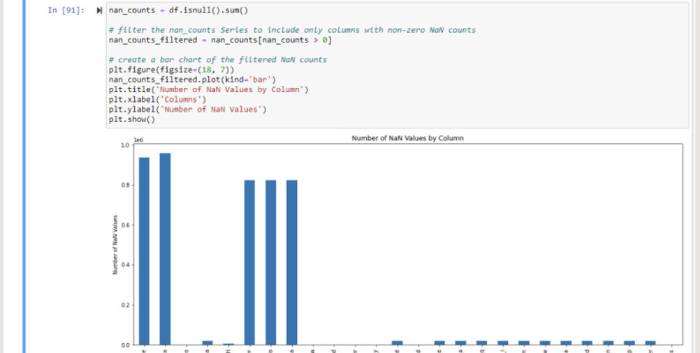
DATA PREPARATION
The null values have been identified and processed to clean the data

Slide 18
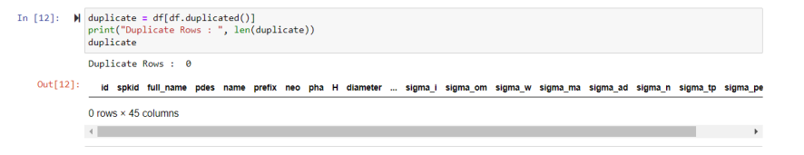
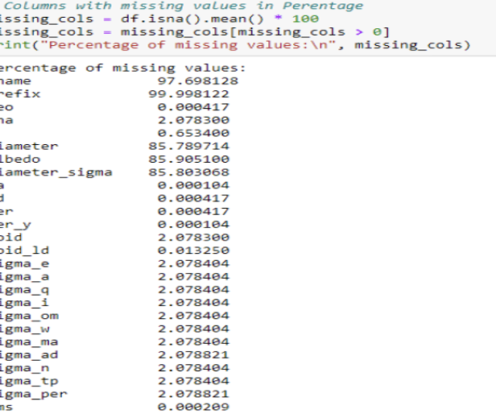
The duplicate values have been searched but found none.
The missing values found maximum in the respective columns have been searched to drop accordingly since the columns with huge proportions of missing values are insignificant in performing analysis.

Slide 19
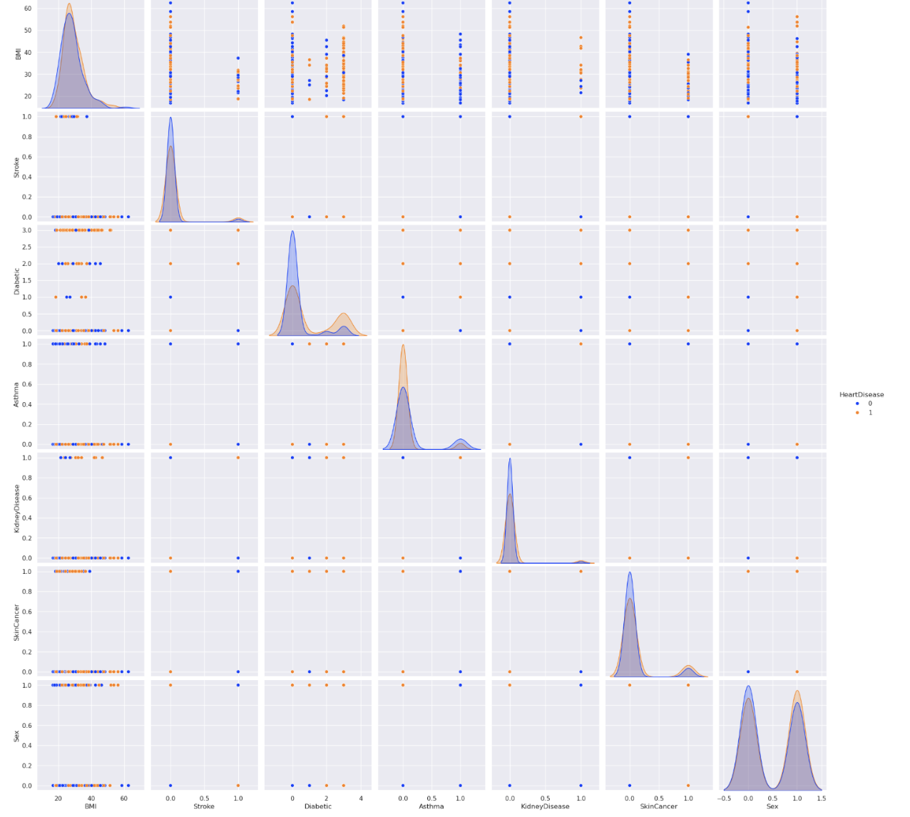
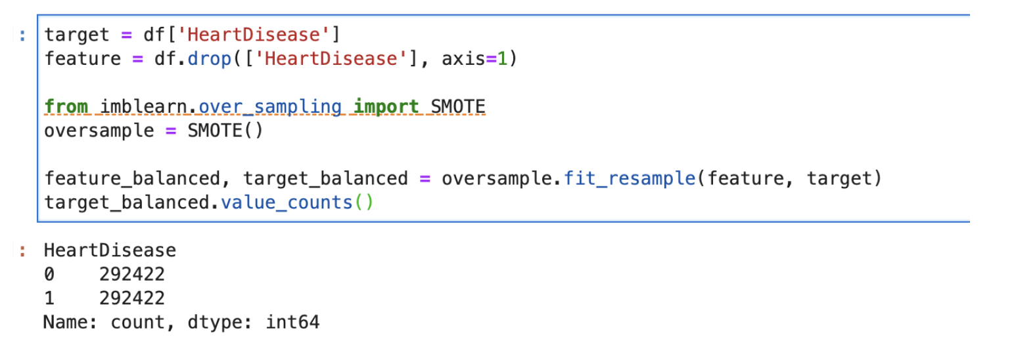
Resampling the data using SMOTE
Notes:
SMOTE (Synthetic Minority Over-sampling Technique) resampling is performed on the dataset to address the class imbalance problem. SMOTE resampling generates synthetic examples for the minority class by creating new instances that are combinations of existing minority class instances. This helps to balance the dataset and improve the performance of the machine learning model in predicting both classes. By oversampling the minority class in this way, the model is exposed to more diverse examples of that class and is less likely to miss important patterns in the data that are specific to that class.After this we obtain uniformly classified data values.

Slide 20
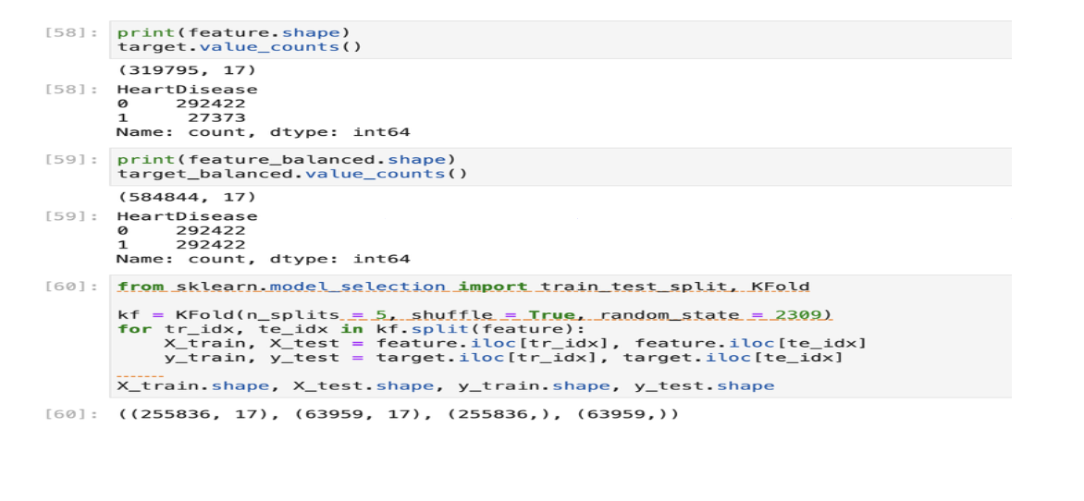
Splitting the data into test and train subsets

Slide 21
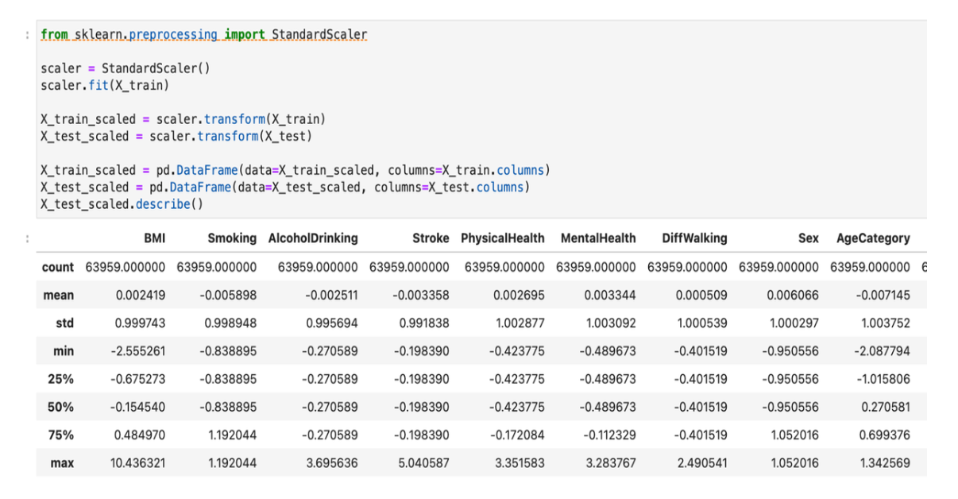
Feature Scaling
Notes:
Feature scaling is a method used to standardize the range of independent variables or features of data. In our code, we're using StandardScaler from Scikit-learn, which standardizes features by removing the mean and scaling to unit variance.It’s a critical preprocessing step.

Slide 22
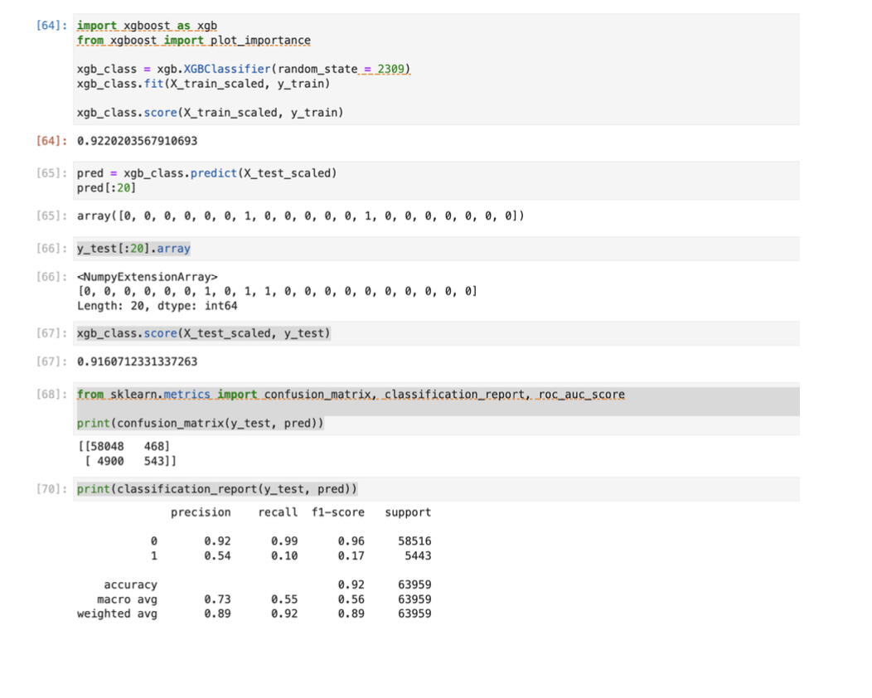
Machine Learning
XGBoost Classifier

Slide 23
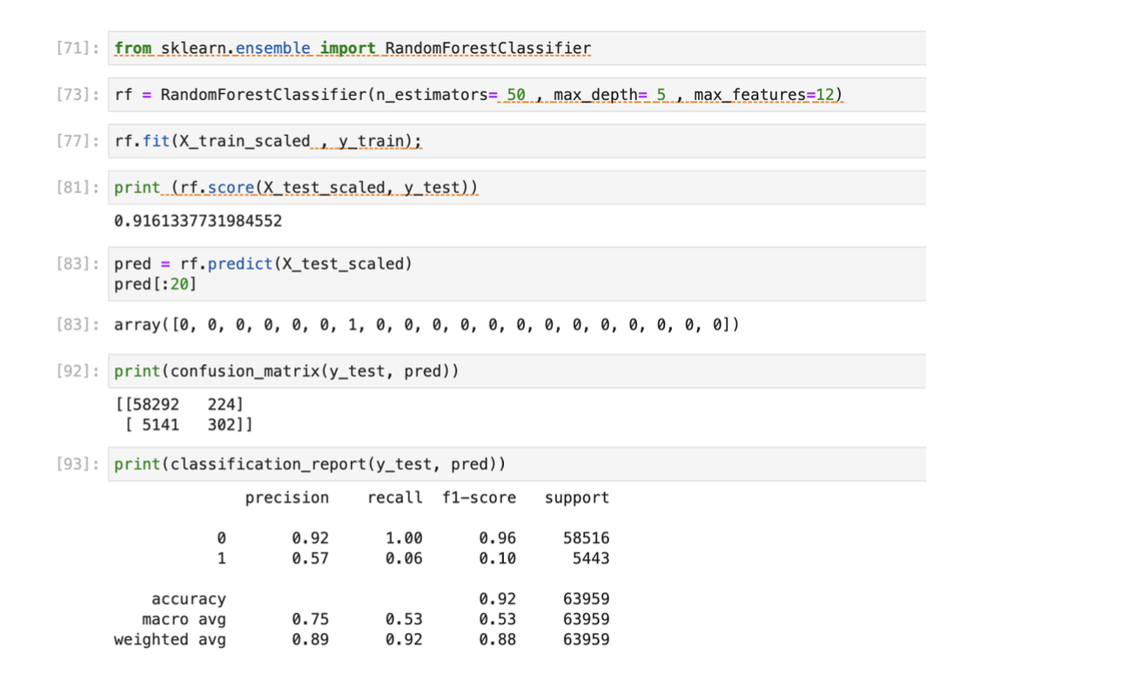
Contd..
Random Forest Classifier

Slide 24
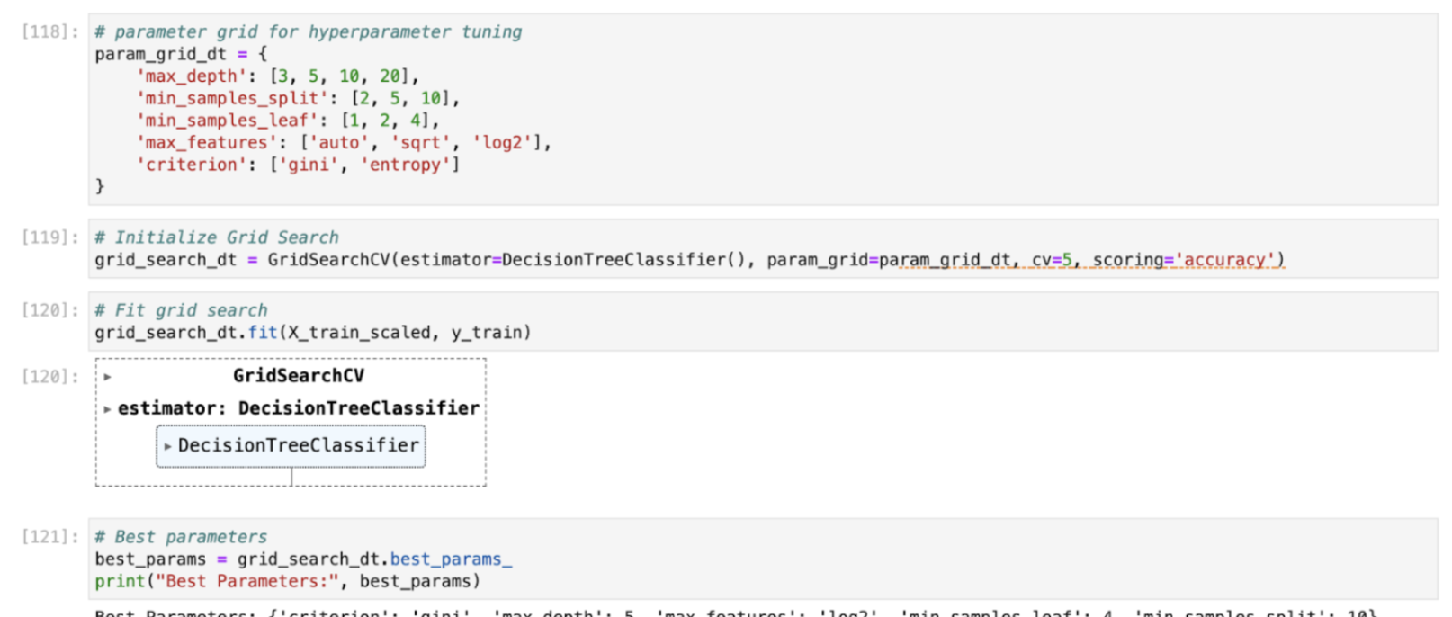
Hyperparameter Tuning
Notes:
Involves adjusting the parameters of the model to improve performance. It is the process of finding the most optimal parameters for a machine learning model.
To implement hyperparameter tuning,the steps are:
● Hyperparameter tuningDefine a range of values for each hyperparameter.
● Use a method like grid search, random search, or Bayesian optimization (as provided by SageMaker) to explore different combinations of these
hyperparameters.
● Evaluate model performance for each combination to find the best set of
hyperparameters.

Slide 25
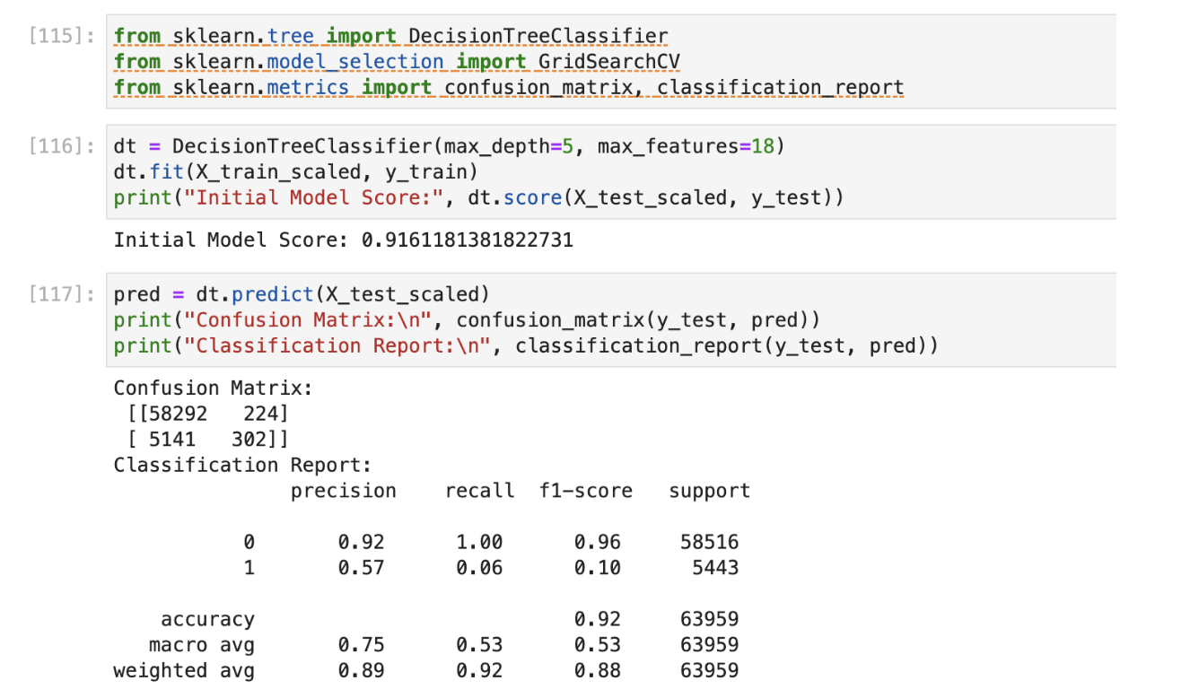
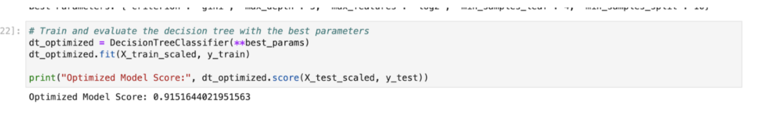
Comparison Results of Decision Trees
Before hyper parameter tuning
After hyperparameter tuning
Notes:
The model performed well without hyper tuning.And hyper tuning was not applied to XGBoost as it requires a lot of execution time and is time consuming.

Slide 26
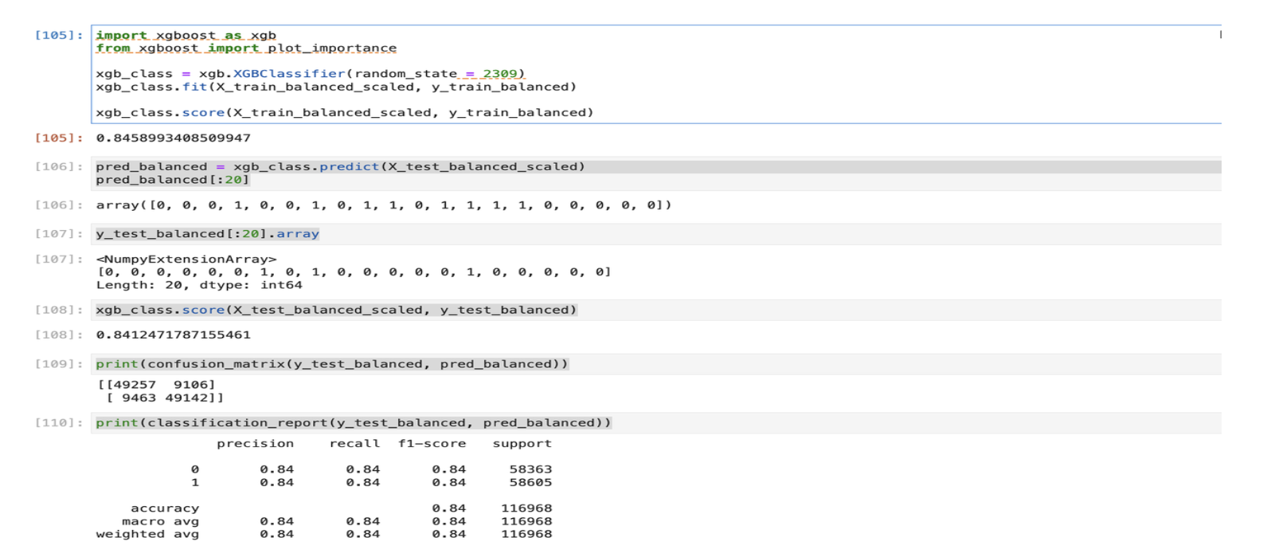
XGBoost with Balanced Data

Slide 27
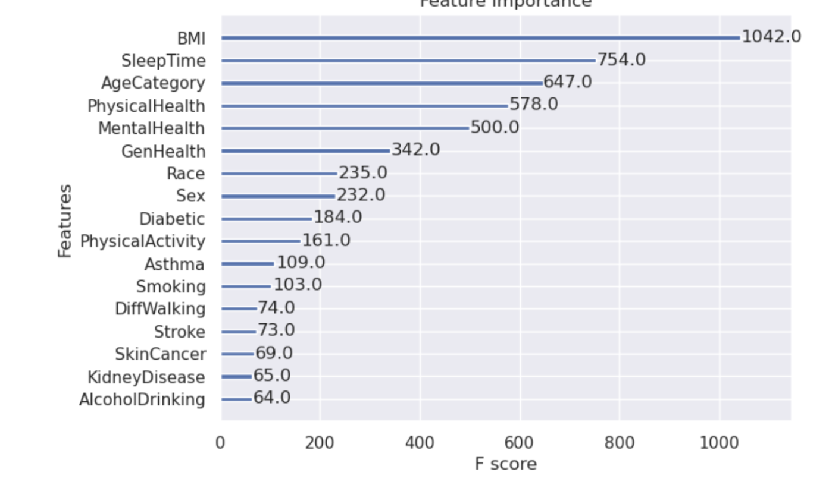
Feature Importance

Slide 28
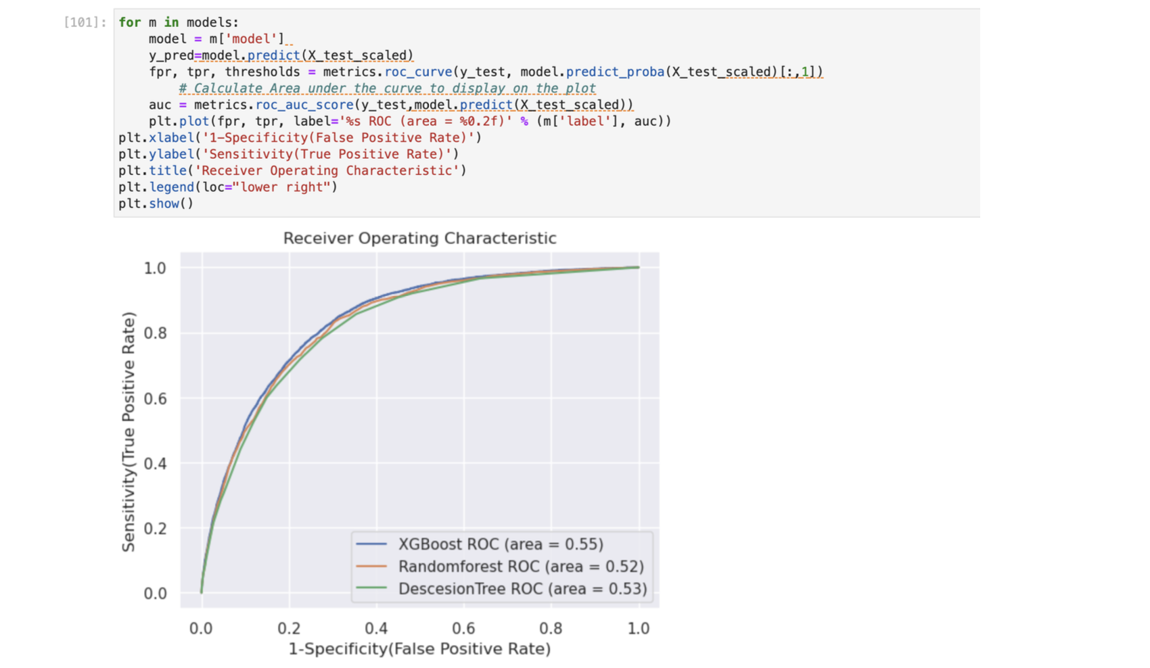
EVALUATION
Notes:
The AUC provides a single number summary of the model performance. Robustness to Cutoff Changes: Unlike accuracy, precision, or recall, which depend on a specific classification threshold, the AUC provides a measure that is independent of any particular threshold. This is particularly useful when we do not have a clear idea of where to set the threshold, or when the cost/seriousness of false positives and false negatives varies
Performance at Various Thresholds:The ROC curve provides a comprehensive view of a model's performance across a range of classification thresholds. It plots the True Positive Rate (TPR) against the False Positive Rate (FPR), allowing us to evaluate the trade-offs between correctly predicting the positive class and incorrectly predicting the negative class as positive.
● Imbalanced Classes: ROC curves are useful in this situation as we have imbalanced classes. In such cases, metrics like accuracy can be misleading, but the ROC curve remains a reliable indicator of the model's ability to distinguish between classes.
● Comparability: We have multiple models, ROC curves offer a clear visual tool to compare their performance. The closer the curve follows the left-hand border and then the top border of the ROC space, the more accurate the test.

Slide 29
RESULTS
ROC and AUC are chosen for their ability to provide a comprehensive, comparable, and threshold-independent assessment of a model's performance, especially in scenarios with imbalanced classes or when comparing multiple models. XGBoost, Random Forest, and Decision Tree — exhibit similar performance in discriminating between the positive and negative classes for the given dataset, as indicated by the overlapping ROC curves. Hyper parameter tuning further decreased the performance of the model hence hyper tuning was not necessary and Hyper parameter tuning was not applied to XGBoost as it requires lot of execution time. The results show that BMI, sleep time, age category and Physical health play a crucial role in deciding the heart health.

Slide 30
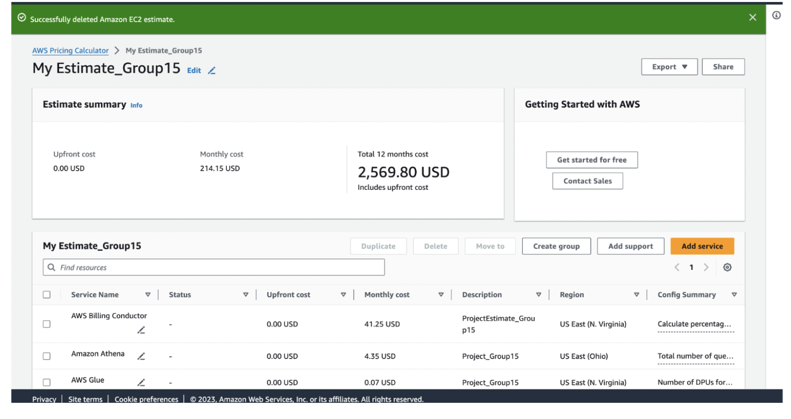
AWS Price Estimator

Slide 31
THANK YOU

